Slide 1
Breast Cancer Data - Feature Selection
Ashish Deo
Prasad Akmar

Slide 2
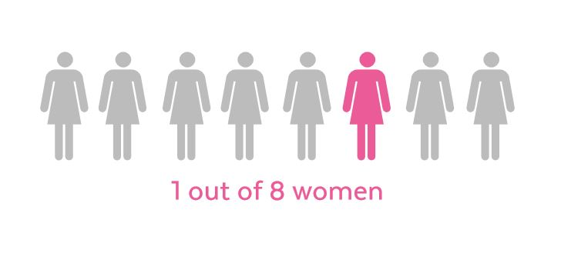

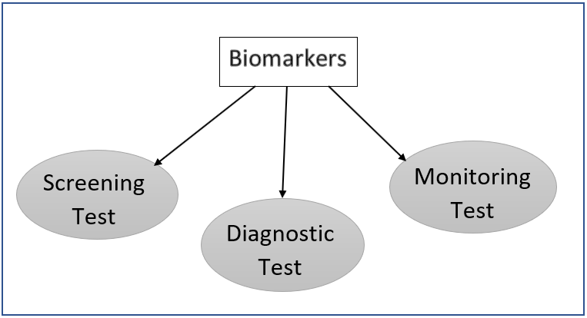
Why this Project?
Notes:
1 in 8 women in United States will be diagnosed with breast cancer in her lifetime
Second leading cause of death due to cancer
Early detection is the key to treating cancer
5 yr survival rate for women with stage 0 and stage 1 is breast cancer 100% and it decreases significantly as it moves to later stages
Different sets of biomarkers: screening test, diagnostic test and monitoring test
Idea is to identify significant feature set across Biomarkers

Slide 3
Dataset - Wisconsin
Original | Diagnostic |  | Coimbra
Observational Data by Dr. WIlliam H. Wolberg. | Data from a digitized image of a fine needle aspirate (FNA) |  | Data from a digitized image of a fine needle aspirate (FNA)
Instances - 699 Attributes – 10 | Instances: 569 Attributes: 32 |  | Instances: 116 Attributes: 10
Clump Thickness Uniformity of Cell Size Uniformity of Cell Shape Marginal Adhesion Single Epithelial Cell Size Bare Nuclei Bland Chromatin Normal Nucleoli Mitoses | Perimeter Smoothness Compactness Concave points Fractal dimension Concavity Symmetry | Radius Area Texture | Age BMI Glucose Insulin HOMA Leptin Adiponectin Resistin MCP.1
Notes:
Wisconsin original - information and featureset
Creator : Dr. WIlliam H. Wolberg (physician)
Origins: University of Wisconsin Hospitals
Attributes : 699 records, 9 features (collected over Jan 1989 to Nov 1991) benign: 458 malignant: 241
Wisconsin Diagnostic - information and featureset
Creator: Dr. William H. Wolberg, W. Nick Street, Olvi L. Mangasarian
Origins: University of Wisconsin Hospitals
They describe characteristics of the cell nuclei present in the image.
Attributes: 569 records, 32 features, computed from a digitized image of a fine needle aspirate (FNA) of a breast mass. B: 357 M: 212
Breast Cancer Coimbra Data Set
Creator: Miguel Patrício(miguelpatricio '@' gmail.com), José Pereira (jafcpereira '@' gmail.com), Joana Crisóstomo (joanacrisostomo '@' hotmail.com), Paulo Matafome (paulomatafome '@' gmail.com), Raquel Seiça (rmfseica '@' gmail.com), Francisco Caramelo (fcaramelo '@' fmed.uc.pt), all from the Faculty of Medicine of the University of Coimbra and also Manuel Gomes
Origins: University Hospital Centre of Coimbra
There are 10 predictors, all quantitative, and a binary dependent variable, indicating the presence or absence of breast cancer.
The predictors are anthropometric data and parameters which can be gathered in routine blood analysis.
Prediction models based on these predictors, if accurate, can potentially be used as a biomarker of breast cancer.
Attributes: 116 records, 10 features, computed from a digitized image of a fine needle aspirate (FNA) of a breast mass. B: 52 M: 64

Slide 4
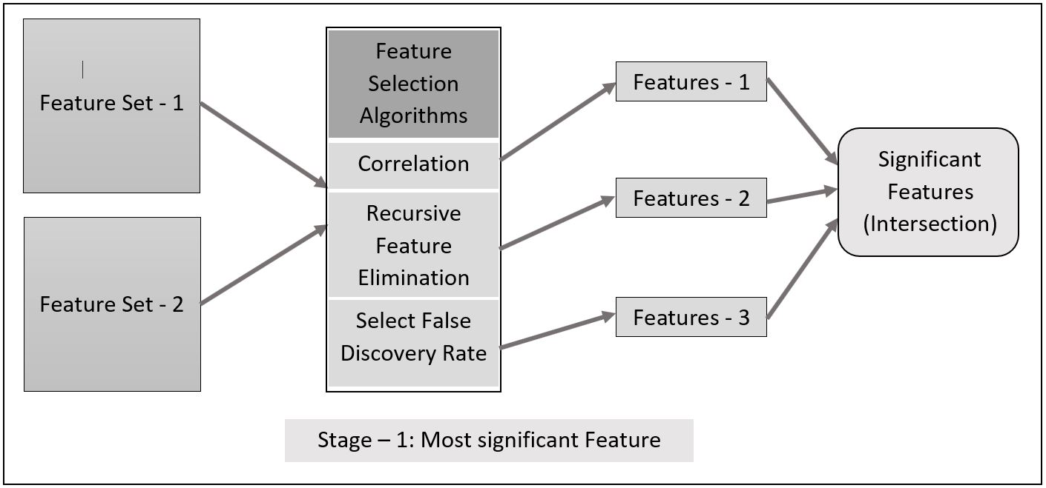
Notes:
Feature selection using Correlation, RFE and GA on Random Forest Algo
Identifying the intersecting feature sets between the comparisons
Combining the most significant features into a single dataset to test with different models and identify the best predictive model with highest accuracy
Manually creating a dataset for training and testing the model

Slide 5
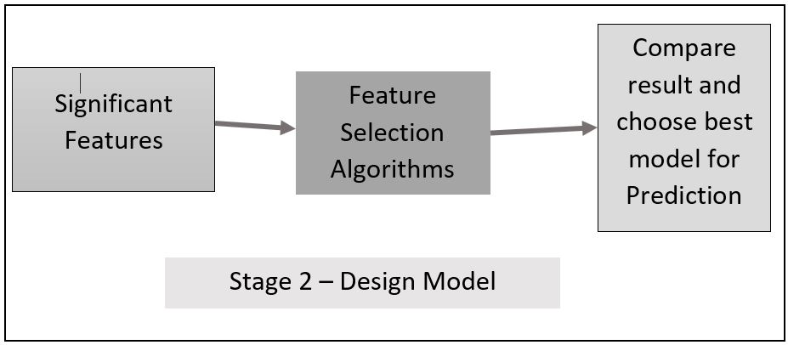

Slide 6
Questions ?

